Slide 1
Time
Time
False
Lunchtime?
🕐
False
Lunchtime?
🕐
…
True
False
Work Time?
🕗
True
Eat lunch
🍱🥗🍔
Eat lunch
🍱🥗🍔
True
…
Do work
👨🏾‍🍳👩🏻‍⚕️

Slide 2
Input
if
conditional
False
True
elif
conditional
False
Do this
True
Do that
Further code

Slide 3
Input
if
conditional
False
True
elif
conditional
False
Do this
True
elif
conditional
False
Do that
True
Do something else
Further code

Slide 4
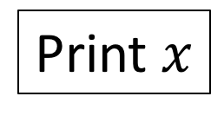
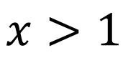
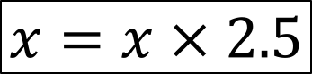
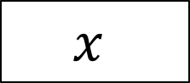
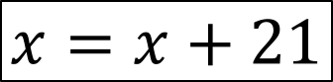
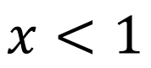
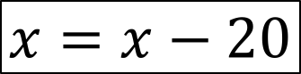
$$x$$
False
$$x>1$$
True
False
$$x=x−20$$
$$x<1$$
True
$$x=x+21$$
$$x=x × 2.5$$
Print $x$

Slide 5
Approach castle. 🏰
Castle door is closed.
Find key. 🗝
False
Pick up key?
🗝
True
Key exlodes! 🗝💥
You die! ☠️
Castle door opens
False
Enter castle?
True
Find treasure. 💍
You win! 🌟
No treasure.
You lose!😖

Slide 6
JPY
Market rate = 0.0091 USD
False
JPY<10,000
True
False
multiplier = 0.9
JPY<100,000
True
False
multiplier = 0.925
JPY<1,000,000
True
False
multiplier = 0.95
JPY<10,000,000
True
multiplier = 0.97
multiplier = 0.98
Print amount paid (JPY)
Print amount received (USD)
Print effective rate

Slide 7
JPY
cash/non-cash transaction
Market rate = 0.0091 USD
False
JPY<10,000
True
False
multiplier = 0.9
JPY<100,000
True
False
multiplier = 0.925
JPY<1,000,000
True
False
multiplier = 0.95
JPY<10,000,000
True
multiplier = 0.97
multiplier = 0.98
Cash?
cash_multiplier = 0.9
Print amount paid (JPY)
Print amount received (USD)
Print effective rate

Slide 8
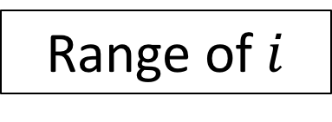
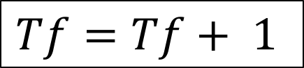
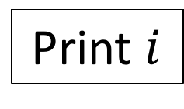
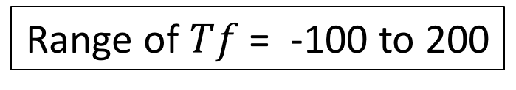
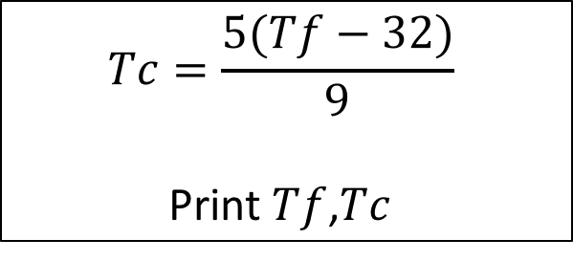
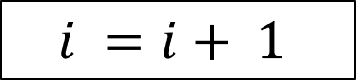
Print heading for table
Range of $Tf$ = -100 to 200
Range of $i$
For loop
$$Tc=\frac{5(Tf−32)}{9}$$
Print $Tf$,$Tc$
Print $i$
$$i =i+ 1$$
$$Tf=Tf+ 1$$
End of range?
End of range?
False
False
True
True
stop
stop

Slide 9
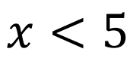
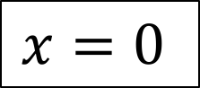

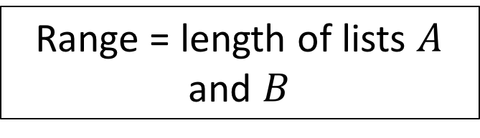
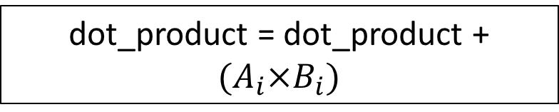
Initialise variable dot_product
$$x=0$$
Range = length of lists $A$ and $B$
While loop
Do something
Next $i$ in range
True
dot_product = dot_product + ${(A}_{i}×B_{i})$
$$x<5$$
False
stop
End of range?
False
True
print dot_product

Slide 10
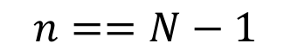
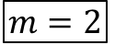
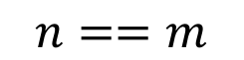
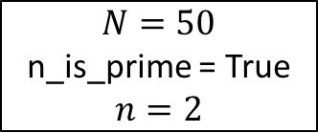
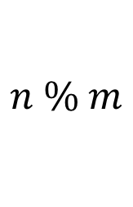
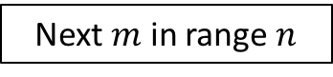
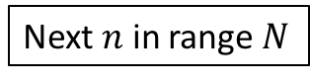
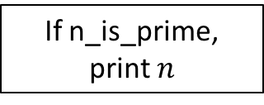
$N=50$
n_is_prime = True
$$n=2$$
For loop 1
Next $n$ in range $N$
$$m=2$$
For loop 2
Next $m$ in range $n$
$$n \% m$$
n_is_prime = False
False
True
$$n==m$$
False
True
$$n==N−1$$
False
True
If n_is_prime, print $n$

Slide 11
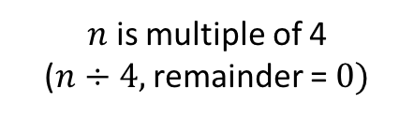
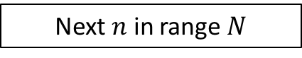
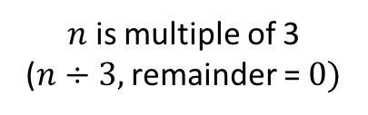
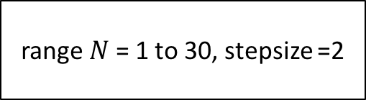
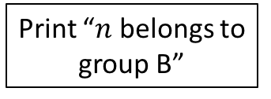
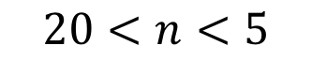
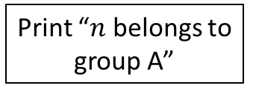
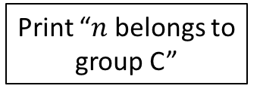
range $N$ = 1 to 30, stepsize =2
Next $n$ in range $N$
$n$ is multiple of 3
($n÷3,$ remainder = $0)$
False
True
we used
$n$ is multiple of 4
($n÷4,$ remainder = $0)$
False
Print “$n$ belongs to group A”
True
False
$$20<n<5$$
True
Print “$n$ belongs to group B”
Print “$n$ belongs to group C”

Slide 12
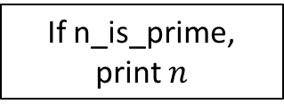
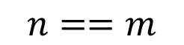
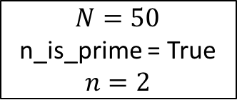
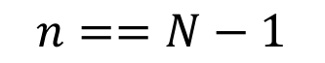
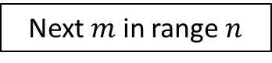
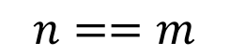
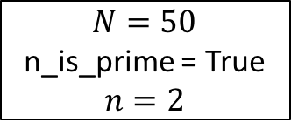
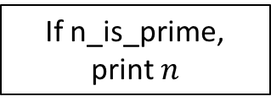
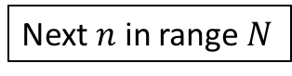
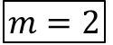
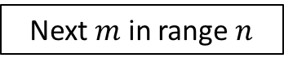
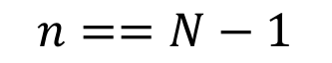
$N=50$
n_is_prime = True
$$n=2$$
$N=50$
n_is_prime = True
$$n=2$$
For loop 1
$$m=2$$
For loop 2
$$m=2$$
False
Next $n$ in range $N$
$$n \% m$$
Next $n$ in range $N$
$$n \% m$$
n_is_prime = False
True
False
Next $m$ in range $n$
True
Next $m$ in range $n$
$$n==m$$
Break
False
$$n==m$$
False
True
True
$$n==N−1$$
False
$$n==N−1$$
True
False
True
If n_is_prime, print $n$
If n_is_prime, print $n$

Slide 13
Enter loop
Enter loop
Next iteration in loop
Next iteration in loop
Break?
False
Continue?
True
True
False
Exit loop : UP one level of indentation (next block or code OR enclosing loop)
Do operations within loop

Slide 14
⌀40
80
400
240
200
300
10
600

Slide 15
my_list = []
for r in range(5):
my_function
my_list = []
for r in range(5):
print(r)
r = r + 2
print(r)
my_list.append(r)
my_list = []
for r in range(5):
my_function
my_function
my_function
my_list = []
for r in range(5):
print(r)
r = r + 2
print(r)
my_list.append(r)
my_function

Slide 16
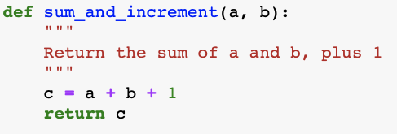
3. () Parentheses, Input arguments
1. Definition keyword
2. Function name
4. Colon
6. Body code
7. Return
5. Documentation string “docstring”

Slide 17
1. Definition keyword
2. Function name
3. () Parentheses, Input arguments
def my_function(r):
print(r)
r = r + 2
print(r)
my_list.append(r)
4. Colon
5. Body code

Slide 18
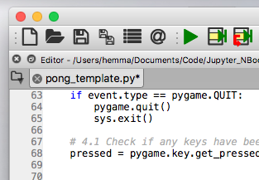

Slide 20
home folder
home folder
site_packages
site_packages
numpy
matplotlib
pygame
matplotlib
__init__.py
linalg.py
display.py

Slide 21
home folder
site_packages
my_functions.py
numpy/linalg.py
library
project
import my_functions
import numpy.linalg
main.py
my_func1.py
my_func2.py
my_func1.py
program.py
my_functions.py
pygame/draw.py
import my_functions
import pygame/draw
main.py

Slide 22
A single location in the python path

Slide 23
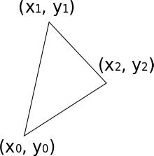
= (1, 4)
= (4, 2)
another_example.py
another_example.py
functions_example.py
another_example.py
functions_example.py
another_example.py
functions_example.py
functions_example.py
= (0, 0)
file_F.py
file_F.py
sibling_folder
file_A.py
sibling_folder
file_E.py
file_A.py
file_E.py
file_B.py
file_E.py
file_F.py
file_A.py
file_B.py
sibling_folder
file_E.py
file_F.py
file_G.py
file_A.py
file_B.py
sibling_folder
file_B.py
file_C.py
file_C.py
file_D.py
file_D.py

Slide 24
another_example.py
functions_example.py
file_E.py
file_F.py
file_A.py
file_B.py
sibling_folder

Slide 25
another_example.py
functions_example.py
file_E.py
file_F.py
file_A.py
file_B.py

Slide 26
another_example.py
functions_example.py
file_E.py
file_F.py
file_A.py
file_B.py
sibling_folder
file_C.py

Slide 27
another_example.py
another_example.py
functions_example.py
functions_example.py
another_example.py
functions_example.py
another_example.py
functions_example.py
functions_example.py
file_F.py
file_F.py
sibling_folder
file_A.py
sibling_folder
file_E.py
file_A.py
file_E.py
file_B.py
file_E.py
file_F.py
file_A.py
file_B.py
sibling_folder
file_F.py
file_A.py
file_B.py
sibling_folder
file_E.py
file_A.py
file_B.py
file_B.py
file_C.py
file_C.py
file_D.py
file_D.py

Slide 28
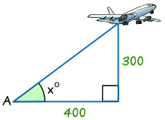

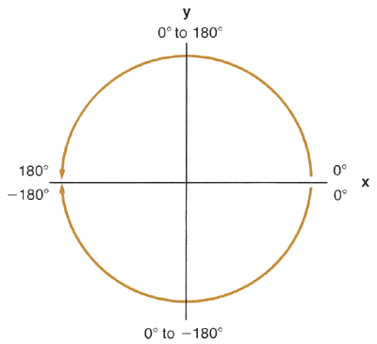
home folder
site_packages
pygame
matplotlib
draw.py

Slide 29
mouse_pos
saucer_pos
s_size[x]
300
s_size[y]
400
saucer_center =
(saucer_pos[x] + s_size[x]/2, saucer_pos[y] + s_size[y]/2)
mouse_pos
saucer_center
300
300
400
400
400

Slide 30


Slide 31



Slide 32

$$v′$$

Slide 34



$$u_{in },C_{in}$$
$$M_{S}$$
$$u_{out },C_{out}$$

Slide 35


1 1 0
0 1 1
0 1 0

Slide 36
Y
100
GRASS
POND
(100, 60)
45
0
X
0
150

Slide 37


Dr Hemma Philamore
Dr Matthew Hennessy

Slide 38
Y
b
4
10
A
8
a
1
B
C
(2.5, 5)
b
2
4.5
D
3
E
(6, 3)
b
0
X
0
10
a
3
c

